Slide 1
Goal Setting
By
Group 4
Name Class Roll No. University Roll No.
Srijita Bhattacharjee 8 12200119062
Madhurima Ranjit 59 12200119030
Rachana Sengupta 69 12200119015
St Thomas’ College Of Engineering And Technology

Slide 2
Definition of Goal
A goal is an objective or target that someone is trying to reach or achieve.
When we set goals, we envision, plan for, and commit to achieving these desired results.
Goal-setting is the process of taking active steps to achieve your desired outcome.
Each of these major goals can be broken down into smaller, more attainable goals that will propel you towards success.

Slide 3
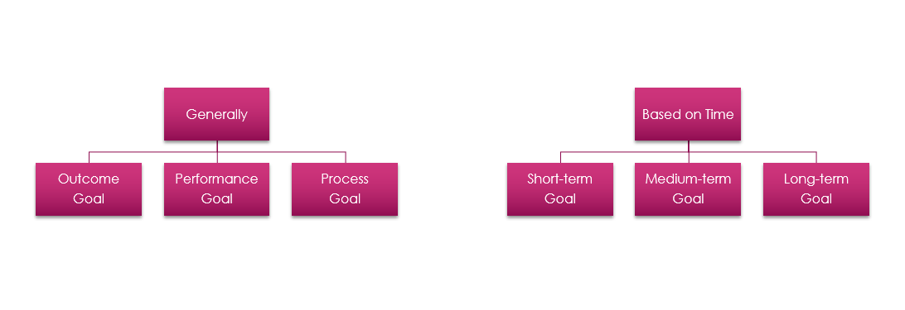
Classification of Goal

Slide 4
Long-term Goal
Srijita | Madhurima | Rachana
Start an organization to help poor people. | Build and run a Public Library. | Open a Cafe.

Slide 5
Performance Goal
Srijita | Madhurima | Rachana
Volunteer at some NGO. Devote weekends for social work and also have a learning experience. Classify the poor like slum based people or homeless people. Meet and associate with like minded people. | Visit local libraries to gain insights and inspiration. Browse books/ articles/ pinterest for decorative inspo. Start saving money. Create a rough planning of building the library. | Collecting photos, designs and menu ideas. Choosing the best location for the cafe. Finding good, reliable suppliers. Calculating the estimated budget for building it and saving accordingly. Developing a brand identity.

Slide 6
Process Goal
Srijita | Madhurima | Rachana
Decide the mission of the organization Register the organization under proper name. Set up board of directors. Recruit volunteers. Recruit staff. Meet with senior volunteers, staff and board of directors to assess the current situation. Raise funds. | Research and reach out to potential donors/ investors/ suppliers. Buy and collect raw materials, furnitures etc. Start the construction. Advertise both on social media and the orthodox way. Buy/collect and arrange the books in shelves. Maintain a register. Recruit staffs. | Developing relationship with suppliers. Get a place at the desired location and start building it in the desired way. Buying decor items, chairs, tables and paints. Buying cooking tools like gas stove, utensils, oven, microwave, fridge etc. Hiring staffs. Marketing. Evaluating the food (Food trials)

Slide 7
Short-term Goal
Srijita | Madhurima | Rachana
Set up a website for the organization with a donation button. Promote the website on social media. Create corporate partnership. Ask for people in the community to donate old clothes, books. Collect leftover food from people and properly store it. | Start looking for a suitably located land. Look for potential vendors to purchase constructional raw materials. Build network with potential donors. Create a network among readers both in real-life and social media for audience. | Planning the layout of the cafe. Visiting other cafes in the town in order to take some inspiration. Finding reliable suppliers. Familiarizing with legal requirements. Designing the logo and the name of the cafe. Deciding the location.

Slide 8
Medium-term Goal
Srijita | Madhurima | Rachana
Distribute the collected clothes and food among needy families. Operate more sites in order to reach more people. Increase donation channels. Find businessmen who are willing to donate their products in small amount to needy people through my organisation. | Buy preferred land along with finishing legal paperworks. Start construction. Buy furnitures and books. Collect books or money from forthcoming donors. | Buying the land to set up the cafe. Buying all the necessary items like decors, paints, chairs, tables, utensils, oven etc. Tying up with Zomato, Swiggy. Setting up an affordable menu card. Food Trials.

Slide 9
Outcome Goal
Srijita | Madhurima | Rachana
Start an organization and be able to help poverty stricken families with clothing or food. | Run a fully-functional public library with varieties of books across different genres. | Opening a cafe with quality food at affordable price and nice ambience.

Slide 10
Thank You!

